Slide 1
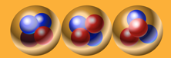
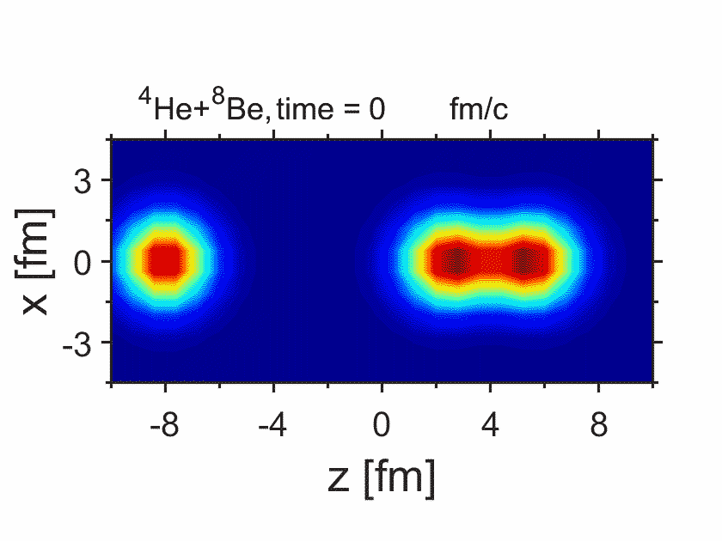
Resonant scattering of ⁴He + ⁸⁸Be
Ren, PWZ, Meng, PLB 801, 135194 (2020)
The linear-chain states are generated, and then evolve to a triangular configuration, and finally to a more compact shape.

Slide 2
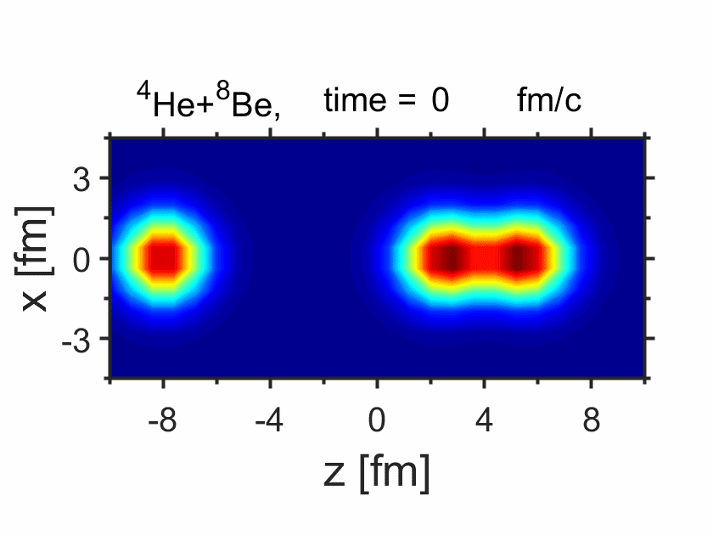
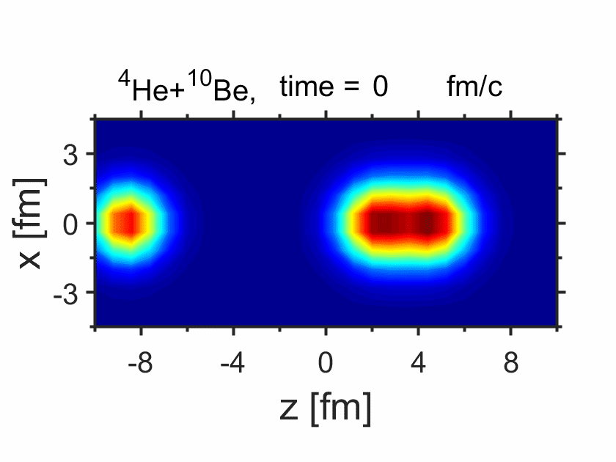
Adding more neutrons: ⁴He +¹⁰Be
Ren, PWZ, Meng, PLB 801, 135194 (2020)
The metastable linear chains can be formed in ⁴He+⁸Be and ⁴He+¹⁰Be collisions.
During the time evolution of the linear-chain configuration, moving clusters can be found.

